Slide 1
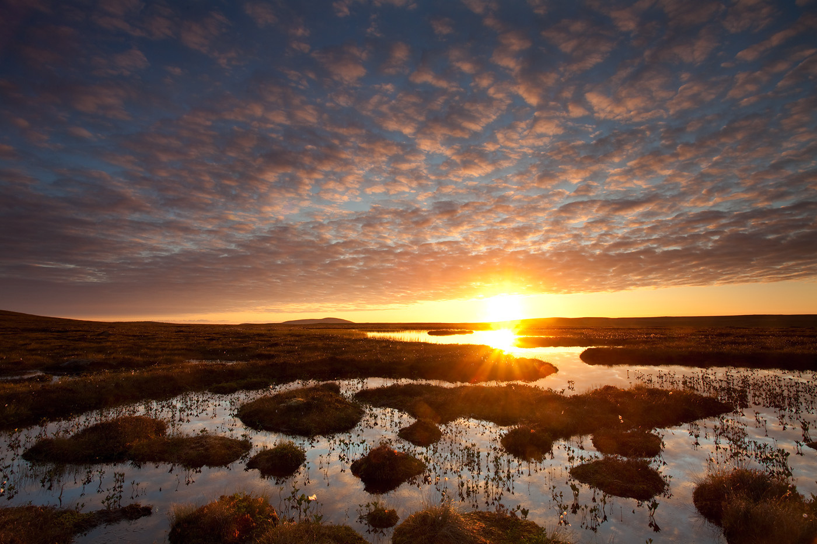

THINK OF A WILD PLACE YOU KNOW WELL: WHAT MAKES IT WILD?
Pools and bog peatland at dawn, Flow Country / Mark Hamblin/2020VISION
  Think about it
  Share your ideas with a partner
  Together, write your definition on a post-it note

Slide 2

DOES NATURE LOOK AFTER ITSELF IN THE PLACES YOU THOUGHT OF?
Why?
Why not?
What needs to change for nature to look after itself?

Slide 3
WHAT IS REWILDING?

Slide 4
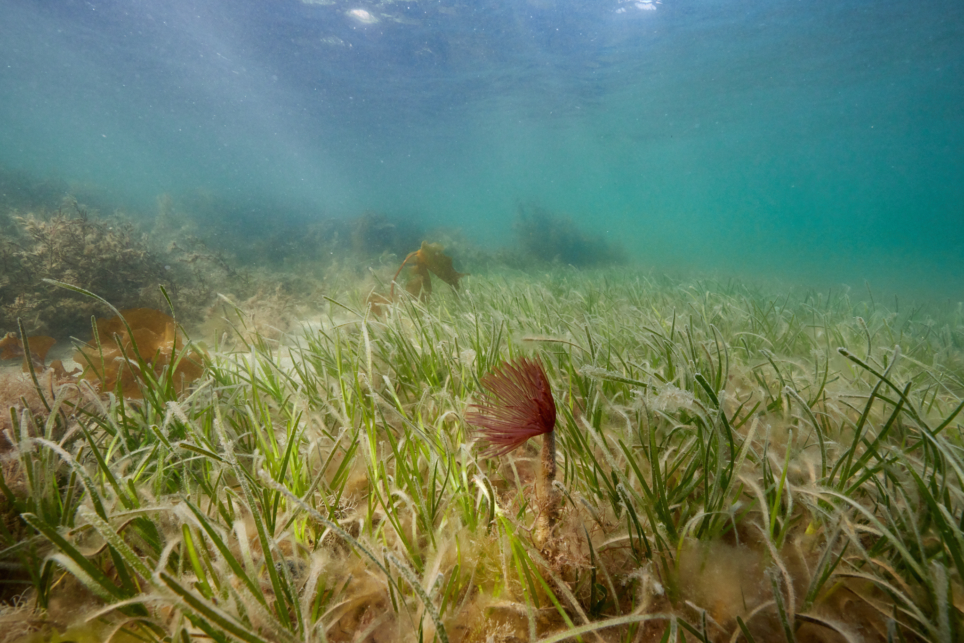
Rewilding is a progressive approach to conservation. It’s about letting nature take care of itself, enabling natural processes to shape land and sea, repair damaged ecosystems and restore degraded landscapes. Through rewilding, wildlife’s natural rhythms create wilder, more biodiverse habitats.
Seagrass meadow with Peacock worm filter feeding in foreground, Loch Craignish / SCOTLAND: The Big Picture

Slide 5
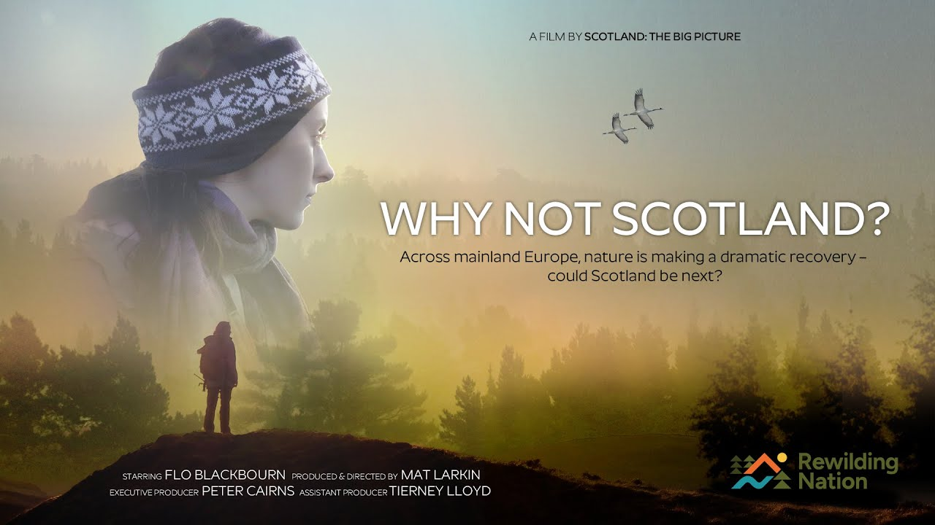
Watch the trailer: https://www.youtube.com/watch?v=3qogJE4sqtw

Slide 6
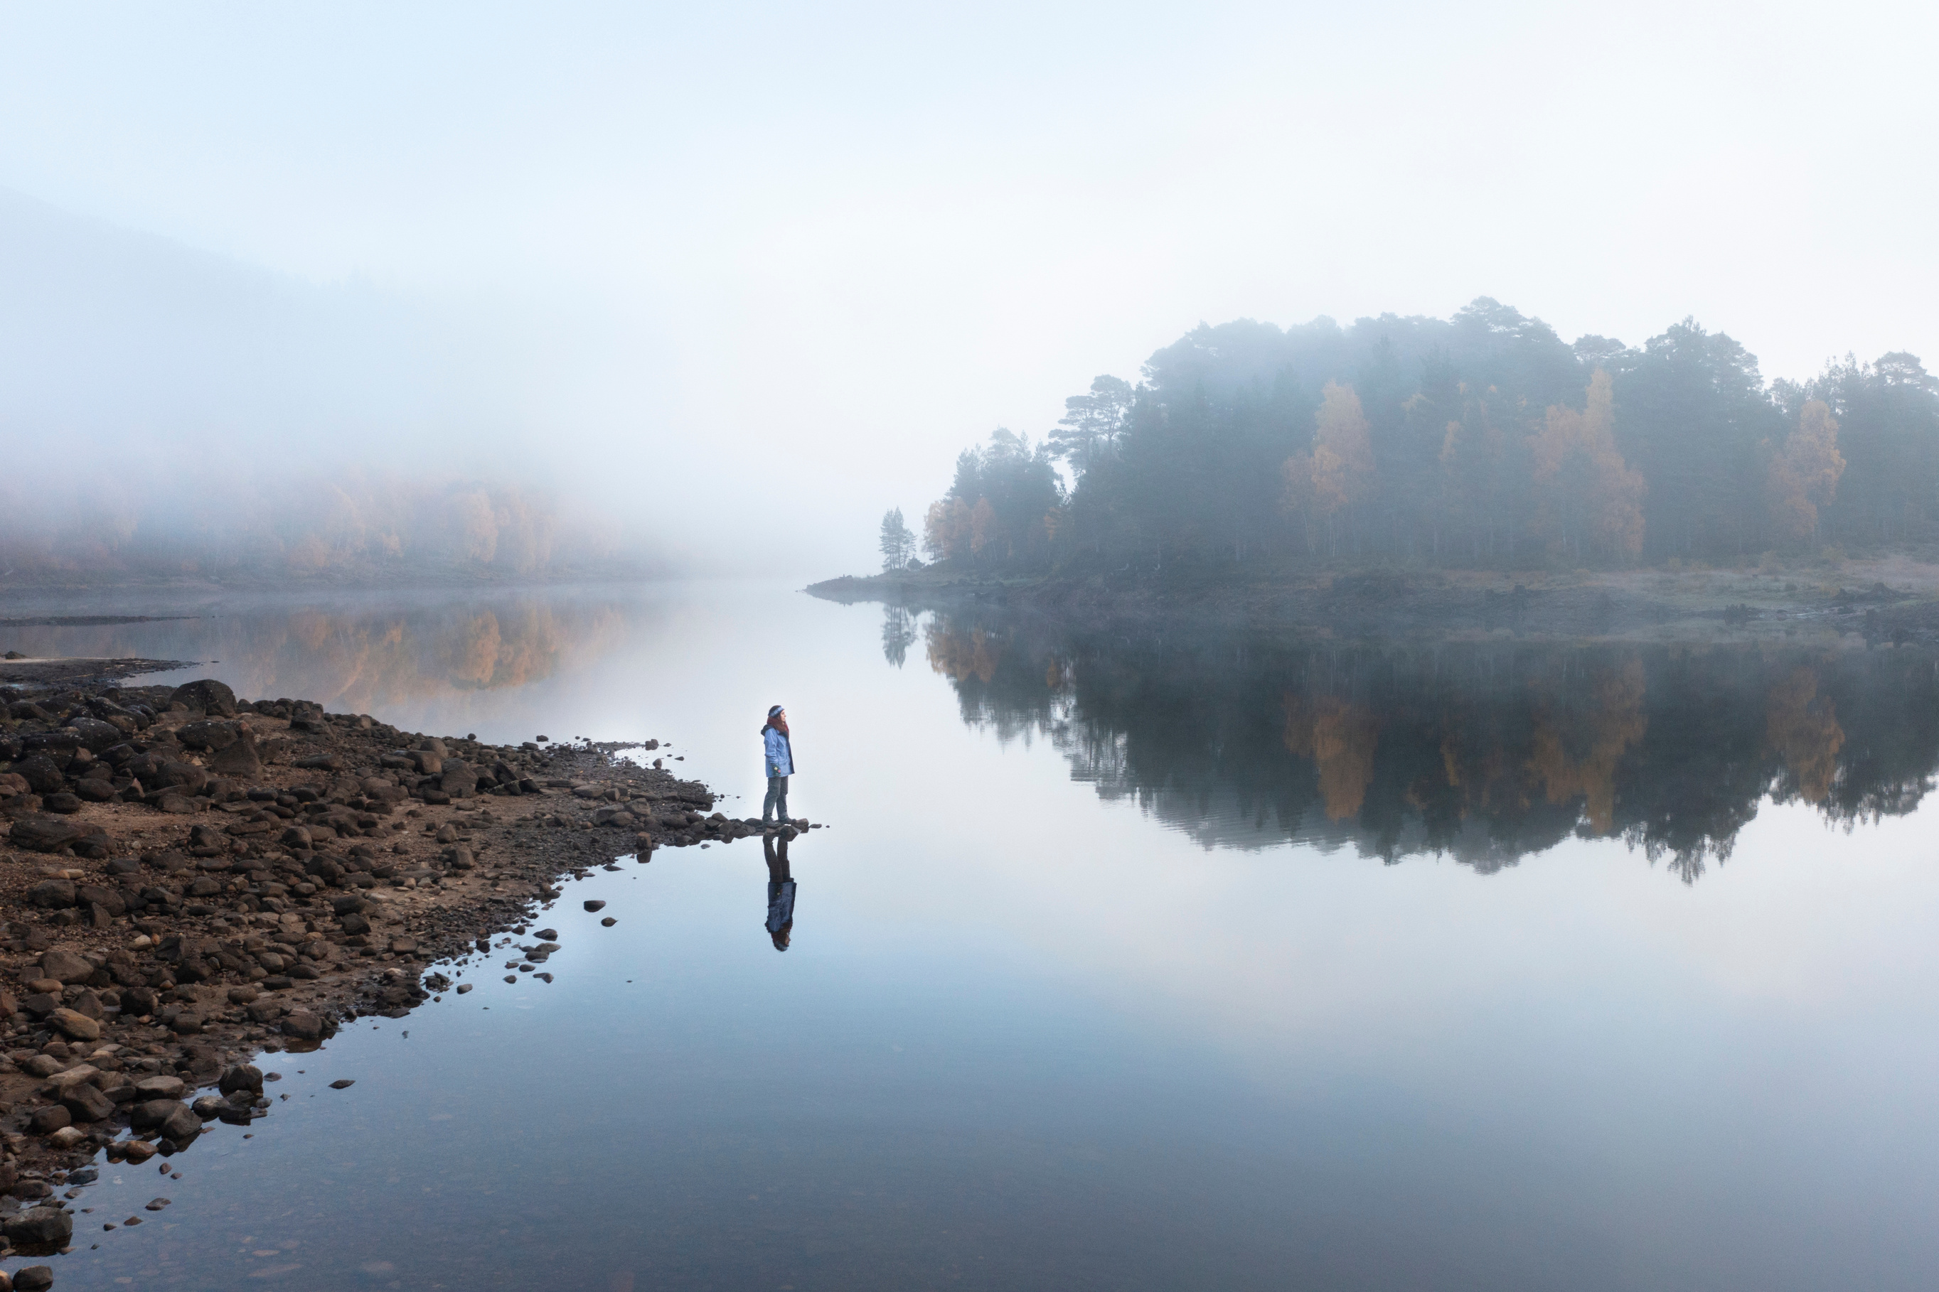
HOW DO YOU FEEL AFTER WATCHING THE TRAILER FOR WHY NOT SCOTLAND?
Do you share Flo’s concerns and feelings of eco-anxiety?
Flo in Glen Affric at sunrise /
Tierney Lloyd/scotlandbigpciture.com

Slide 7
GROUP TASK
  Iberian Highlands (Spain)
  Rhodope Mountains (Bulgaria)
  Greater Coa Valley (Portugal)
  Southern Carpathians (Romania)
  Central Apennines (Italy)
  Swedish Lapland (Sweden)
  Velebit Mountains (Croatia)
  Danube Delta (Ukraine/Moldova/Romania)
  Oder Delta (Germany/Poland)
Research an existing rewilding project currently happening in Europe.
Create a poster, which you will present to the whole class at the end of this session.
Choose from the following rewilding projects:

Slide 8
SUCCESS CRITERIA
Your poster and presentation should provide the answers to the following questions:
  What does your rewilding project do differently to what was happening before it was implemented?
  How does your rewilding project enable wildlife to recover?
  How does your rewilding project benefit human beings as well as the natural world?
  How will your rewilding project make a positive impact in the future?

Slide 9
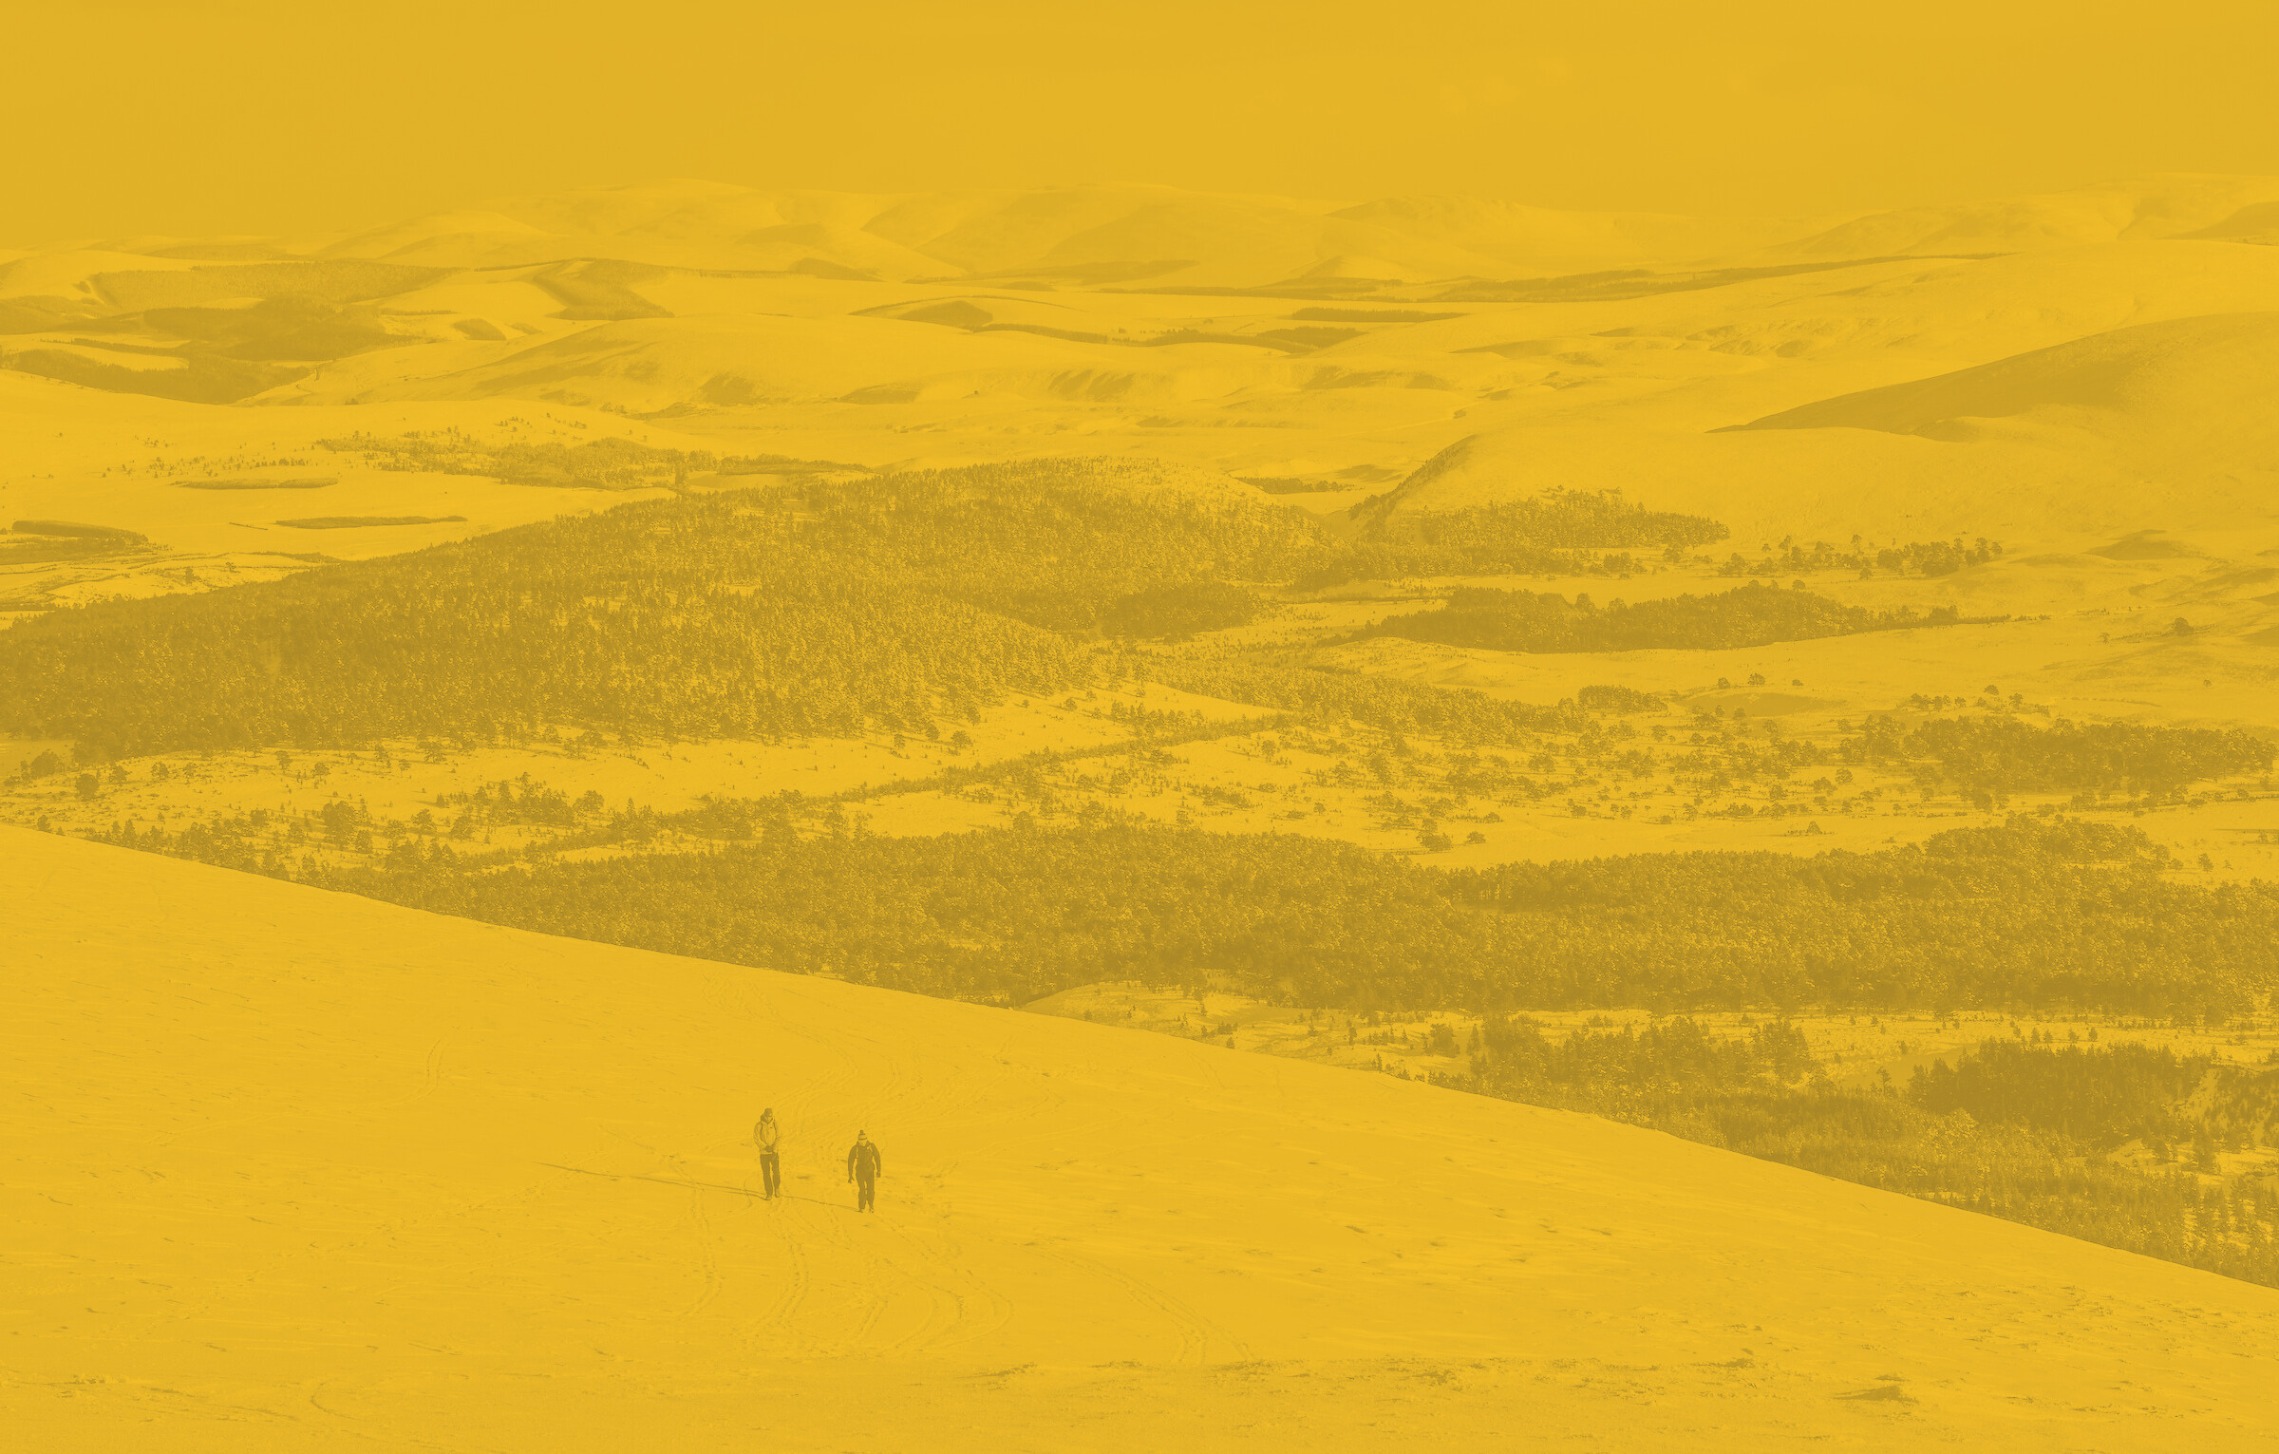
PRESENTATION TIME
Walkers in snow above Caledonian pine forest, Meall a'Bhuachaille, Cairngorms National Park / James Roddie/scotlandbigpicture.com

Slide 10
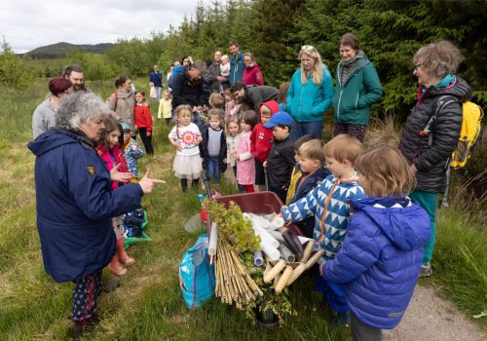
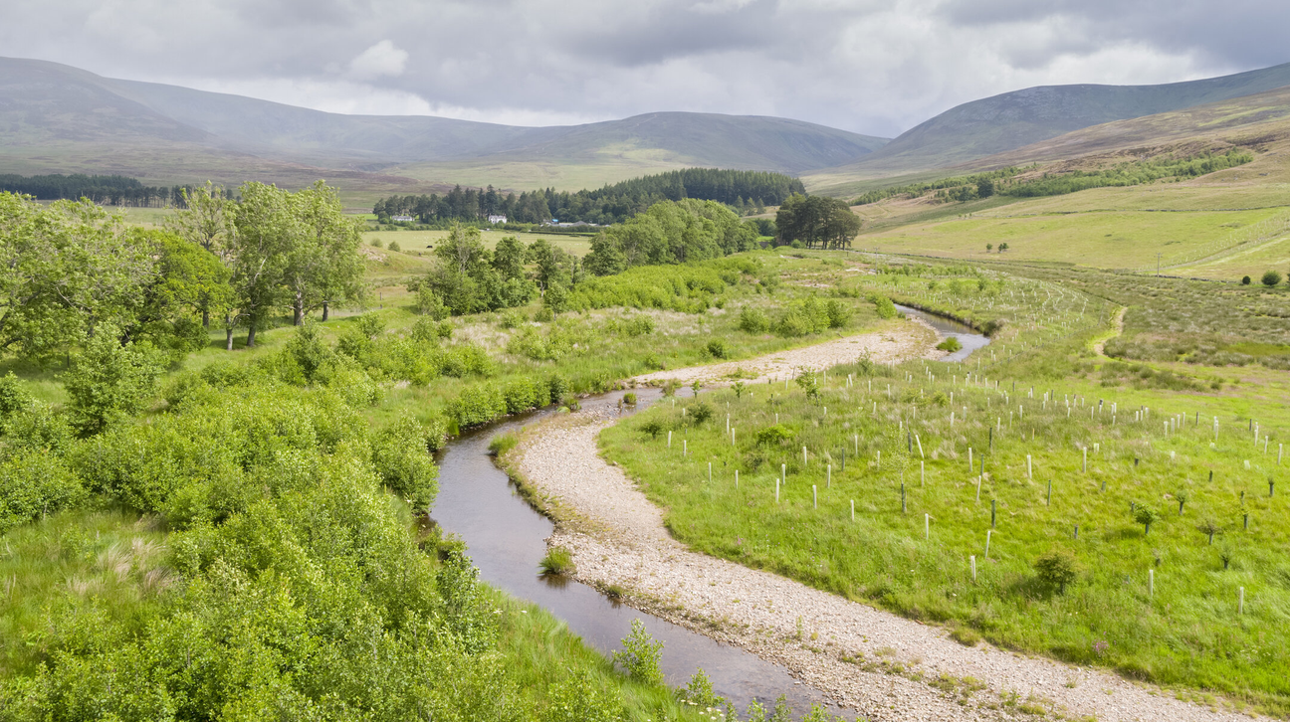
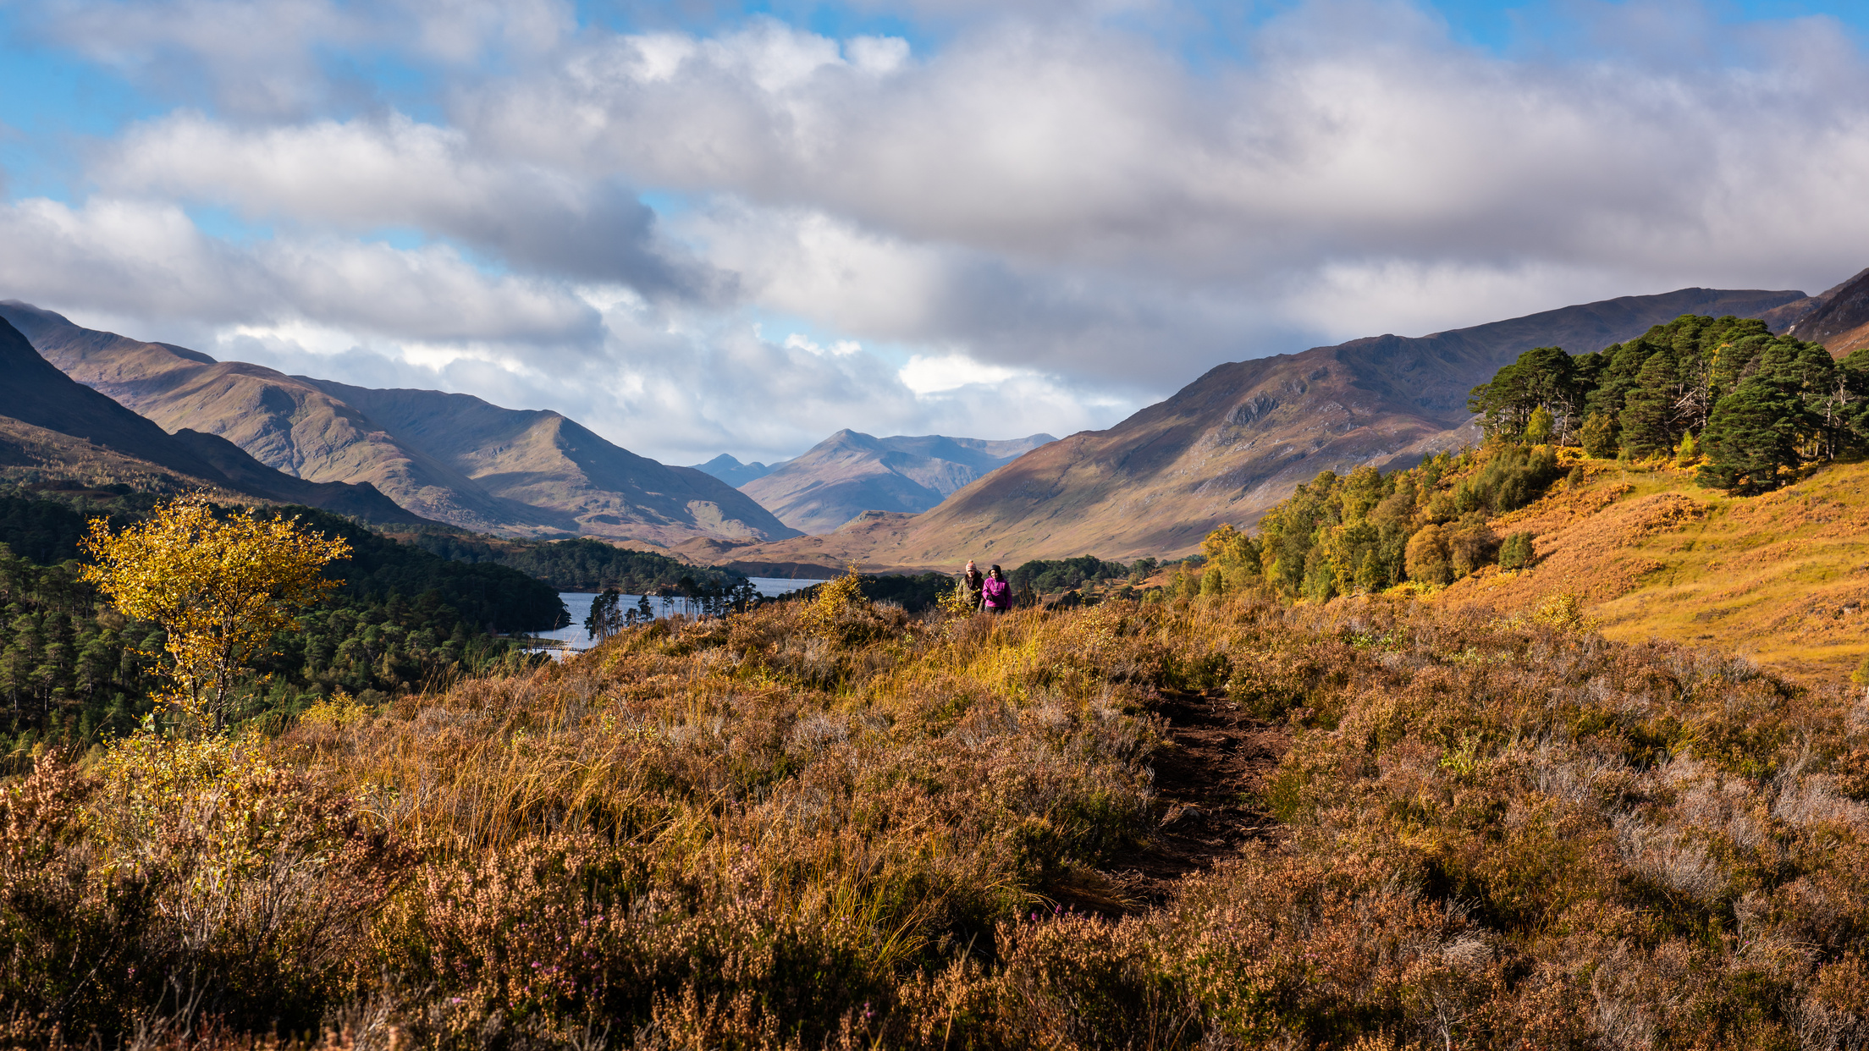
CAN THIS HAPPEN IN SCOTLAND?
Young families gathered around ready for a tree planting event at Abrichan / James Shooter
A remeandered section of Rottal Burn / James Shooter/scotlandbigpicture.com
Walkers in Glen Affric / munro1/Shutterstock
Abriachan: The village that raised a forest
Rewilding the Rottal
Glen Affric, Highlands

Slide 11
THE REWILDING NATION CHARTER
1. REWILDING TO HELP NATURE: Nature gives us the food we eat, the air we breathe, and the water we drink. But if we keep taking too much from nature, it won’t be able to keep giving us these important things. Rewilding is our best chance to help nature get healthy again, so it can keep taking care of us.
2. REWILDING OURSELVES: Nature is best when it’s wild and full of surprises. It’s a place of fun, joy, and wonder. If we want to enjoy all the amazing things nature has to offer, we need to learn to live alongside wild animals and make more room for nature in our everyday lives.
3. REWILDING FOR EVERYONE: We can’t keep doing things the same way anymore. We need to change how we live, but we can only do that if everyone is involved. By working together, we can create a greener and fairer country that everyone can be proud of.
4. REWILDING ON A BIG SCALE: Rewilding can help connect and grow the little bits of nature we have left. This will bring back more plants and animals, making our world a richer place. By rewilding on a big scale, we can help nature thrive again and tackle big problems like climate change.

Slide 12
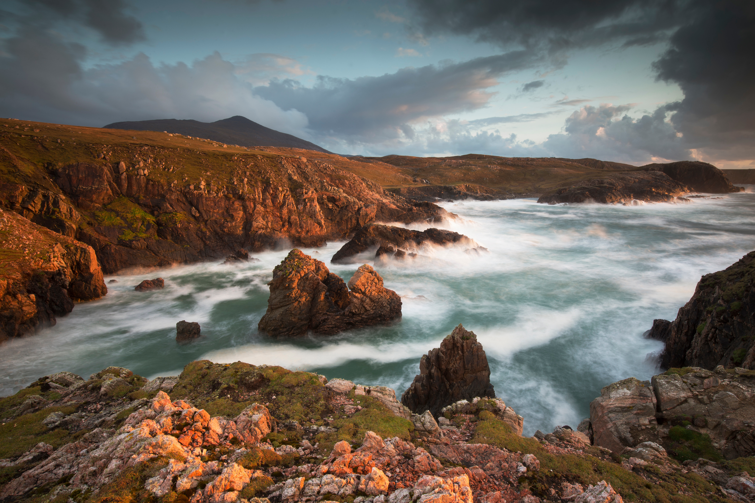
Evening light over west coast of Lewis, Outer Hebrides / Peter Cairns/Northshots
REWILDING NATION CHARTER

